Slide 1
Collision Detection
CS 4730 – Computer Game Design

Slide 2
Topics
Detecting Collisions
Moving everything to shared coordinate space
Simple: Use spheres
A bit harder: Axis aligned hitboxes
harder still: Object-aligned hitboxes
Some advanced techniques:
Swept geometry / bullet through window
Optimization techniques

Slide 3
Topics (Cont’d)
Resolving Collisions
Simple reversal of transformations
Binary Search
Dealing w/ multiple axes, sloped platforms, etc.

Slide 4
Detecting Collisions
Every game relies on Collision Detection.
Determines when interactions between objects occur.
If done poorly, leads to frustration.
If done well, a smooth experience

Slide 5
Step 1. Coordinate Systems

Slide 6
Step 1. Coordinate Systems
Before we even start detecting collisions, we need Sprite locations to be in a shared coordinate system.
But Sprites might be on different branches of our display tree!
Solution: Use AffineTransforms to quickly convert a Sprites location to the global coordinate space.

Slide 7
Step 1. Coordinate Systems
Overall Idea:
Write a method that, for a given display object, returns an Affine Transform which converts from that object’s local space to global space
We will call this the object’s Global Transform
For any points of interest (for collisions), use the transform’s transformPoint(x,y) method to find global versions of points.

Slide 8
Step 1. Coordinate Systems
We can define this Global Transform recursively up the display tree.
Psuedo-code:
AffineTransform at;
if this DO has a parent:
at = get this parent’s global transform (recursively)
//undo parent’s pivot transformation if necessary
apply this object’s transforms to at
return at

Slide 9
Step 2. Determine Collision Shape

Slide 10
Step 2. Determine Collision Shape
Easiest method: Sphere collision

Slide 11
Step 2. Determine Collision Shape
Easiest method: Sphere collision
A collision sphere is just a center point and radius.
Method in DO will find center point, pass through global transform, and return radius as well.

Slide 12
Step 2. Determine Collision Shape
Easiest method: Sphere collision
SIDE NOTE:
Notice all that empty space around Mario.
What problems would this cause?
How would we easily fix this?
What are the issues with the fix?

Slide 13
Step 2. Determine Collision Shape
Easiest method: Sphere collision

Slide 14
Step 2. Determine Collision Shape
Harder method: Axis Aligned Hitbox

Slide 15
Step 2. Determine Collision Shape
Harder method: Axis Aligned Hitbox
If Sprites might be rotated, need to find the black box in image left.
Use transform to find four corners of green box.
transform (0,0),(0,width),(height,0),(width,height).

Slide 16
Step 2. Determine Collision Shape
Harder method: Axis Aligned Hitbox
Given corners of green box, return corners of black box.
Involves simply mixing and matching the coordinates.
e.g., upper left is min of all x coords and min of all y coords.

Slide 17
Step 2. Determine Collision Shape
Harder method: Axis Aligned Hitbox
Why?
Well, doing the actual collision detection with axis aligned boxes is MUCH easier.

Slide 18
Step 2. Determine Collision Shape
Harder method: Object Aligned Hitbox

Slide 19
Step 2. Determine Collision Shape
Harder method: Object Aligned Hitbox
Use transform to find four corners of green box.
pass (0,0),(0,width),(height,0),(width,height) through global transform

Slide 20
Step 2. Determine Collision Shape
Harder method: Object Aligned Hitbox
Why?
More accurate hit detection (especially if rotation involved).
But…harder to detect the collisions.

Slide 21
Step 2. Determine Collision Shape
Last Tip: Multiple Hitboxes

Slide 22
Step 2. Determine Collision Shape
What about 3D Games?
Very similar
Hit Sphere: Transform will get you center point and radius
Hit 3D Box (axis-aligned). Send eight corners through the transform, take min/max in each dimension
Hit 3D Box (object-aligned). Send eight corners through the transform.

Slide 23
Step 3. Detect Collisions

Slide 24
Step 3. Detect Collisions
Easiest method: Sphere collision
Actual collision detection is just distance formula.
If two objects have radii r1 and r2, they collide if center points are r1+r2 or closer to each other.

Slide 25
Step 3. Detect Collisions
still easy method: Axis-Aligned Boxes collision
Overlap testing made easier because axis-aligned.
Solution:
If x ranges overlap and y ranges overlap, then collision!!

Slide 26
Step 3. Detect Collisions
Hard method: Object-aligned Boxes collision
Overall Approach:
See if any of the individual line segments intersect.
If not, See if any one corner from either hitbox is inside the other.

Slide 27
Step 3. Detect Collisions
First, check if any line segments intersect
Works for most cases
Counter-example: One box completely inside other.
Solution: Test if one corner of each box inside other.

Slide 28
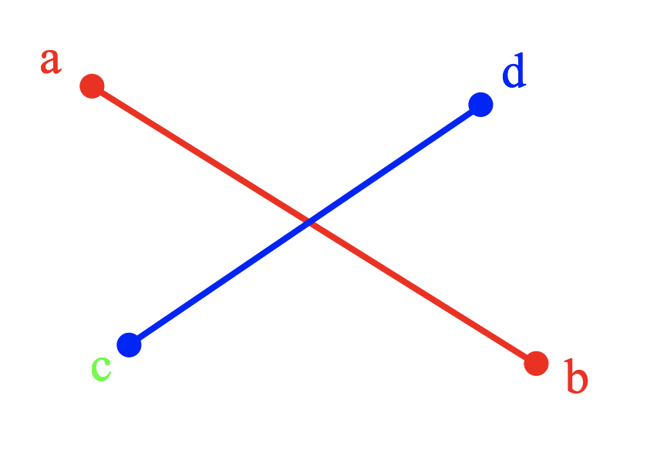
Step 3. Detect Collisions
How to check if two line segments intersect?
Couple of ways:
Use line equations and calculate intersect
Use orientation of points!

Slide 29
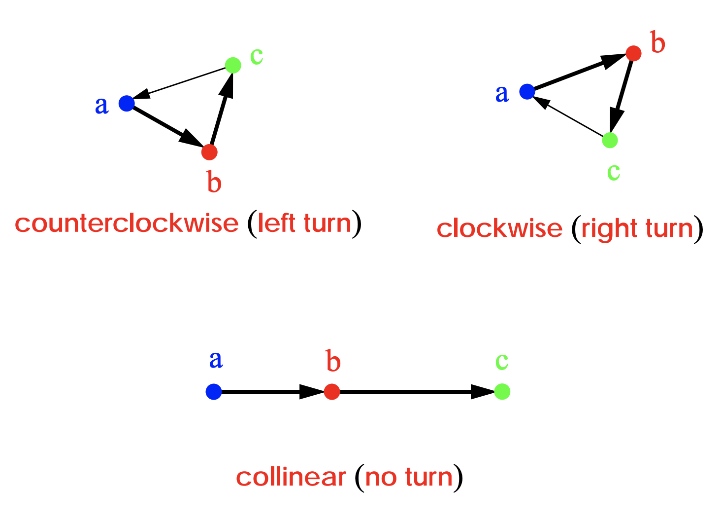
Step 3. Detect Collisions
Any three points (a,b,c) have three possible orientations:

Slide 30
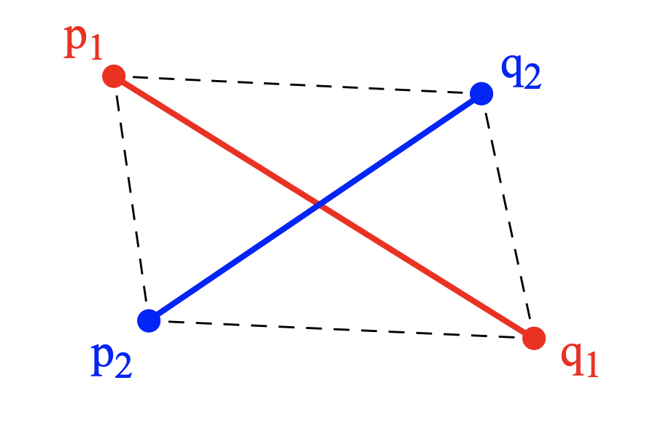
Step 3. Detect Collisions
Two lines intersect if one of the following:
General Case: (p1,q1,p2) and (p1,q1,q2) have different orientations (same for other line)
Special Case: All four points are co-linear and the x-projections overlap.

Slide 31
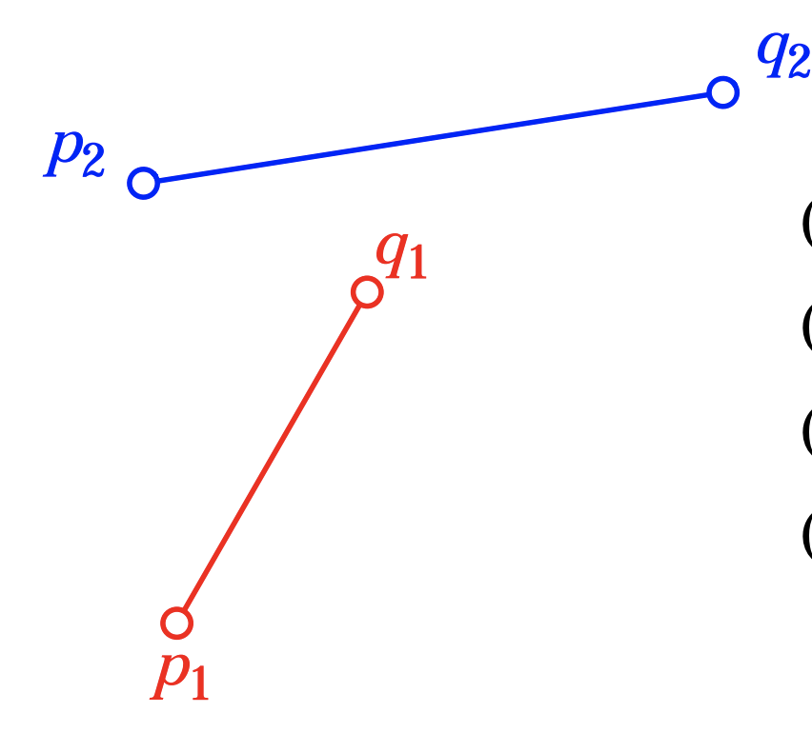
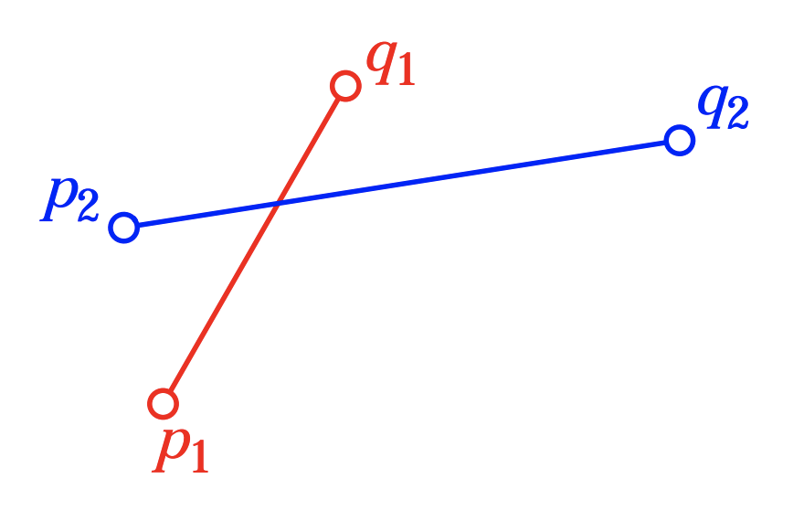
Step 3. Detect Collisions
Two lines intersect if one of the following:
General Case: (p1,q1,p2) and (p1,q1,q2) have different orientations

Slide 32
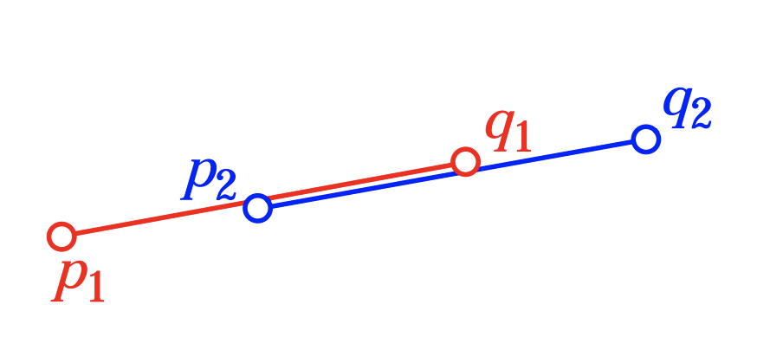
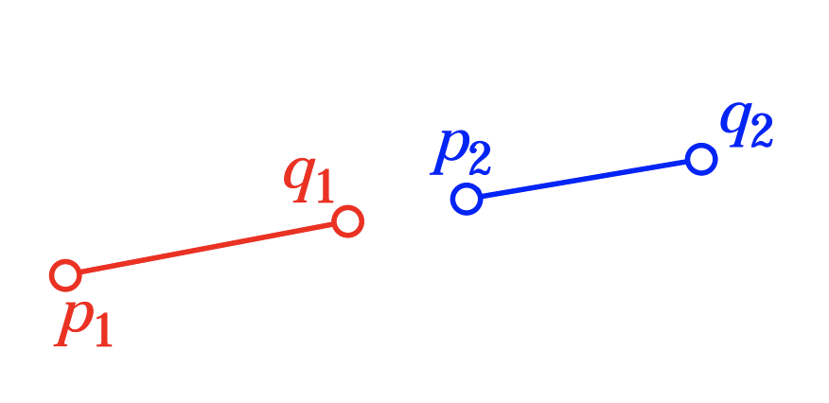
Step 3. Detect Collisions
Two lines intersect if one of the following:
Special Case: All four points are co-linear and the x-projections overlap.

Slide 33
Step 3. Detect Collisions
Ok, so overall algorithm is:
Find the four orientations of interest
o1, o2 (line 1 w/ respect to line 2)
o3, o4 (line 2 w/ respect to line 1)
if o1 != o2 and o3 != o4
General case! Lines intersect!
else check special case!
For each i (1 to 4):
if orientation i == 0 and the point from the other line for that orientation lies on the segment from the main line
Return True! Lines intersect!
If none of this applies, return false.

Slide 34
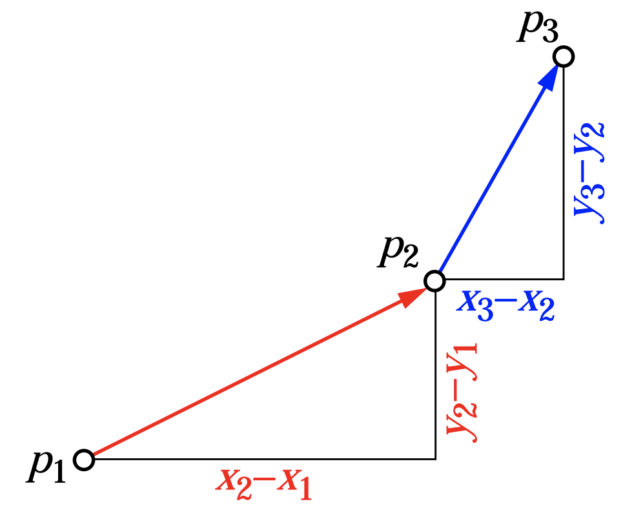
Step 3. Detect Collisions
Last bit: How to compute those orientations?
Compute slope of each line segment
s1 = slope of p1 to p2
s2 = slope of p2 to p3
if s1 < s2
return counterclockwise (left turn)
else if s2 < s1
return clockwise (right turn)
if s1 == s2
return collinear

Slide 35
Step 3. Detect Collisions
Ok, line intersection works except for the special case at bottom.
For this case:
Check any one corner of each hitbox and test if that point inside the other box.
Need to test in both directions!

Slide 36
Step 3. Detect Collisions
How to tell if a point is inside a rectangle?
Easy solution:
Make four triangles
Point is inside hitbox if sum of areas of triangles equals area of hitbox.
Otherwise, not.

Slide 37
Step 3. Detect Collisions
Overall Algorithm:
Get global hitboxes of each object (transform four corners of each hitbox to global space)
Call these hb1 and hb2
For each line segment on hb1 versus line segment on hb2
If line segments overlap, return true!
If no lines intersect
Check one corner of hb1 and see if it is inside hb2
If so, return true
Check one corner of hb2 and see if it is inside hb1
If so, return true
If nothing above applies
Return false

Slide 38
Aside: Some Advanced Things

Slide 39
Problems With Overlaps
What if your Δt is too big?
Well, you can fly right through an object before any collision is actually registered
Kinda hard to do with complex shapes
Picture any game sprite
None of them are actually simple geometric shapes

Slide 40
Overlap Testing
Fails with objects that move too fast
Unlikely to catch time slice during overlap
Possible solutions

Slide 41
Swept Geometry
Extrude geometry in direction of movement
Swept sphere turns into a “capsule” shape

Slide 42
Step 4: Which Objects to Check?

Slide 43
Who’s Colliding?
Compare everything
Check only around the player
Check only in a particular quadrant
Check only around moving objects (i.e. not atRest())
Remember: “perfect is the enemy of good enough”
Don’t go for perfection! Go for “looks right”

Slide 44
How Many Hit Boxes?
In the worst case (with complex objects) this is a pretty hard problem! O(n^2)
For each object i containing polygons p
Test for intersection with object j with polygons q
For polyhedral objects, test if object i penetrates surface of j
Test if vertices of i straddle polygon q of j

Slide 45
Speed Up
To go faster
Sort on one dimension
Bucket sort (i.e. discretize in 1 dimension)
Exploit temporal coherence
Maintain a list of object pairs that are close to each other
Use current speeds to estimate likely collisions
Use cheaper tests

Slide 46
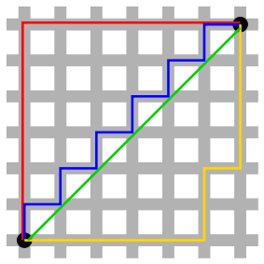
Cheaper Distance Tests
Cheaper distance calculation:
Compare against
Approximation for comparison:
Manhattan distance

Slide 47
Achieving O(n) Time Complexity
One solution is to partition space

Slide 48
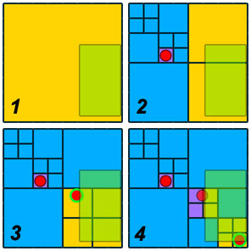
Achieving O(n) Time Complexity
The box collides with the level 1 node – but there are no objects in level 1
The box collides with two level 2 nodes – but there are no objects in them either. However, their child nodes need to be checked now.

Slide 49
Achieving O(n) Time Complexity
The box collides with four level 3 nodes, and there is one object in them, which is added to the return list. Note that there are no level 3 nodes in the top-right level 2 node, so it is not queried any further.

Slide 50
Achieving O(n) Time Complexity
Finally, the box is colliding with six level 4 nodes, one of which contains another object. Note that the object we just returned was on an edge, so it was contained within the level 3 node instead of a level 4 node.
Credit: http://www.kyleschouviller.com/wsuxna/quadtree-source-included/

Slide 51
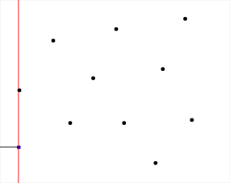
Achieving O(n) Time Complexity
Another solution is the plane sweep algorithm

Slide 52
Step 5: Collision Resolution

Slide 53
Step 5: Collision Resolution
Suppose two objects collide, now what?
We don’t want to leave the objects (usually), they might get “stuck” inside each other.
Some things that need to be considered:
Moving the objects to not be colliding anymore (e.g., player and platform)
Destroying one or both objects (e.g., bullet destroyed once it hits first target)
Playing sound effects
Changing game state (e.g., player health goes down)
Sometimes need to be careful to only do this once!!

Slide 54
Step 5: Collision Resolution
Let’s focus on the most difficult of these problems:
Moving objects so they no longer collide
Initial attempt:
Before moving objects, keep track of the old position, scale, or anything else of interest.
If a collision occurs put these values back to their old values to “resolve” the collision?
Pros? Cons?

Slide 55
Step 5: Collision Resolution
Pros: Very easy to code. Does a reasonable job for simple collisions
Cons: Objects get stuck easily. Consider below (no vertical movement)

Slide 56
Step 5: Collision Resolution
Better: Treat x and y axis independently!
If x movement causes collision, move x back
If y movement causes collision, move y back

Slide 57
Step 5: Collision Resolution
PROBLEM: If neither x nor y cause a collision on their own!
Need to check this case!

Slide 58
Step 5: Collision Resolution
More problems: What if we want sloped platforms?
Pushing right would NOT allow Mario to walk up the slope

Slide 59
Step 5: Collision Resolution
Possible solutions for this sort of thing:
Use normal to the surface to push Mario out (not perfect, Mario will slide down slope due to gravity)
Pixel by pixel manipulation (to figure out pixel by pixel if Mario is moving left or right, otherwise don’t move Mario)
Etc.

Slide 60
Step 5: Collision Resolution
Last thing:
What if Mario is moving very fast? Might lead to a “gap” in between Mario and platform.

Slide 61
Overlap Testing

